Slide 1
1033 & 2020 CIS-550: Fall, 2020 Group Presentation

Slide 2
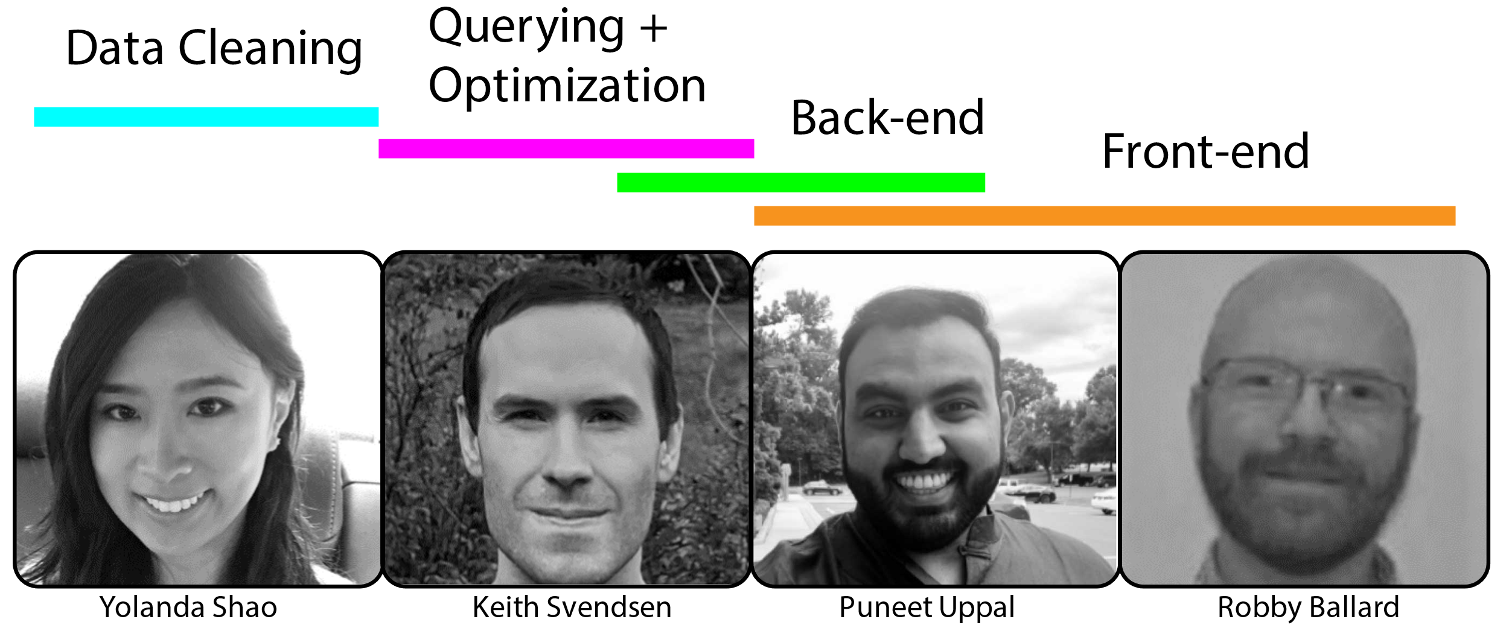
Project analysis slide 8
Team Members

Slide 3
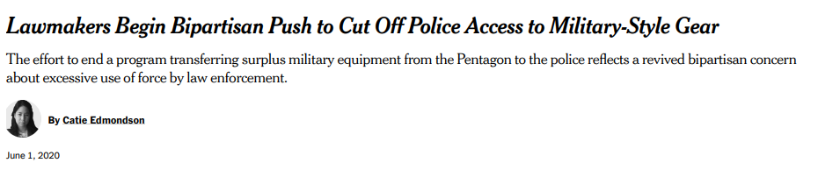
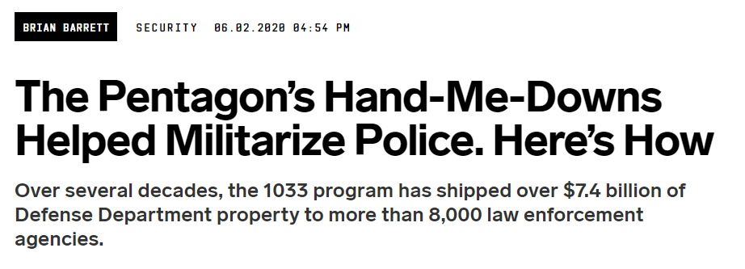
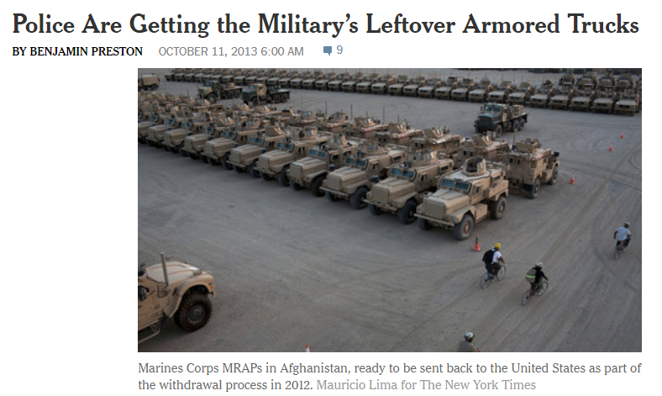



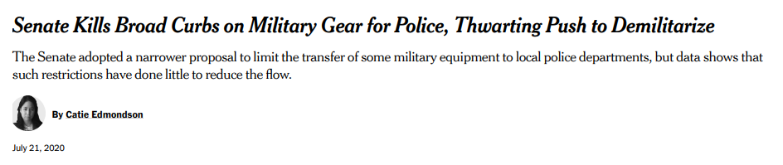

Slide 4
Project analysis slide 3
Project Analysis
Fundamental Question:
What About Poverty…
Or Race?
Is This Normal?
Does the degree of participation by a given county’s law enforcement agencies (LEA) in the 1033 Program correlate with a violent response to protests in the wake of George Floyd’s murder in the US?
Does the rate of poverty in a given county have any impact on the type or amount of 1033 equipment requested by that county’s LEA’s?
How does the racial makeup of a given county affect what type and how much 1033 equipment is requested by that county’s LEAs?
How does the situation in a given county compare to similarly sized counties throughout the United States?

Slide 5
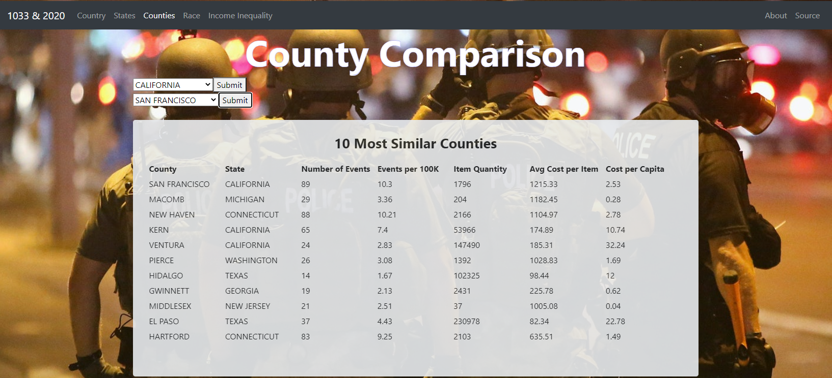

Slide 6
Project analysis slide 10
Datasets
American Community Survey (ACS)
US Crisis Monitor
County level data on race, economics, and education compiled and presented by the US Census Bureau.
3,220 rows, representing all counties in the 50 states as well as DC and Puerto Rico.
Nationwide data covering the participants, locations, outcomes, and types of political protest in all 50 states, as well as the District of Columbia. 17,675 rows of data representing all recorded acts of political protest from 5/24/2020-11/21/2020
General Services Administration
County level, nationwide data representing all 243,492 acknowledged distributions of 1033 equipment to law enforcement agencies (LEAs) throughout all 50 states, DC, and Puerto Rico.

Slide 7
Project analysis slide 4
Project Analysis
Add County ID# to 1033 & ACS datasets
Assess data for missing, NULL, or abnormal entries..
Data Review
Classify Equipment in 1033 Dataset
Data Cleaning
Data Polishing
.
Standardize “County” attribute in all datasets..
Correct character accents, standardize use of -, ‘, . Characters.
Standardize Capitalization, remove “COUNTY”, “CDA”, “BOROUGH”.
JOIN Formation
Handle Non-Duplicate Double Entries

Slide 8
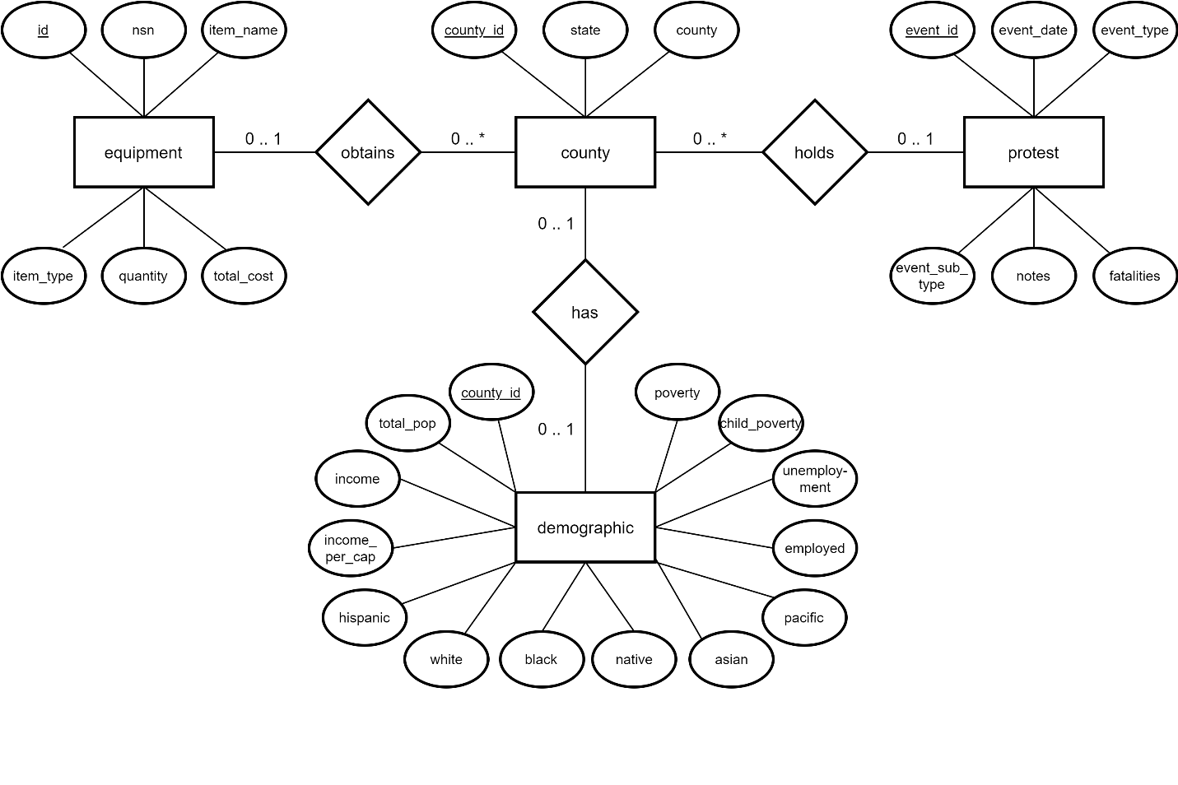
Project analysis slide 10
ER Diagram

Slide 9
Project analysis slide 11
Complex Query
State | Population | Peaceful | Non_peaceful | Peaceful_per_100K | Non_peaceful_per_100K | Equip_qty | Weapon_qty | Equip_cost | Weapon_cost, Cost_per_equip | Cost_per_weapon | Equip_cost_per_cap | Weapon_cost_per_cap
WITH d1 AS
(SELECT state, SUM(total_pop) AS population
FROM demographic d JOIN county c ON d.county_id=c.county_id GROUP BY state),
p1 AS
(SELECT state, COUNT(*) AS peaceful
FROM protest p JOIN county c ON p.county_id=c.county_id
WHERE sub_event_type="Peaceful protest" GROUP BY state),
p2 AS
(SELECT state, COUNT(*) AS non_peaceful
FROM protest p JOIN county c ON p.county_id=c.county_id
WHERE event_type<>"Strategic Developments" AND sub_event_type<>"Peaceful protest" GROUP BY state),
e1 AS
(SELECT state, SUM(quantity) AS equip_qty, SUM(total_cost) AS equip_cost
FROM equipment e JOIN county c ON e.county_id=c.county_id
WHERE item_type<>"WEAPON" GROUP BY state),
e2 AS
(SELECT state, SUM(quantity) AS weapon_qty, SUM(total_cost) AS weapon_cost
FROM equipment e JOIN county c ON e.county_id = c.county_id
WHERE item_type="WEAPON" GROUP BY state)
SELECT d1.state, population, peaceful, non_peaceful, ROUND((peaceful/population*100000),2) AS peaceful_per_100K, ROUND( (non_peaceful/population*100000),2) AS non_peaceful_per_100K, equip_qty, weapon_qty, equip_cost, weapon_cost, ROUND((equip_cost/equip_qty),2) AS cost_per_equip, ROUND((weapon_cost/weapon_qty),2) AS cost_per_weapon, ROUND((equip_cost/population),2) AS equip_cost_per_cap, ROUND((weapon_cost/population),2) AS weapon_cost_per_cap
FROM d1 LEFT OUTER JOIN p1 on d1.state=p1.state LEFT OUTER JOIN p2 on d1.state=p2.state LEFT OUTER JOIN e1 ON d1.state=e1.state LEFT OUTER JOIN e2 ON d1.state=e2.state;

Slide 10
Project analysis slide 11
Selected Query Optimization Statistics
Query Number | Pre-Optimization Avg. | Post-Optimization Avg. | Percent Change
Query 1 | 0.449 sec | 0.297 sec | -33.8%
Query 9b | 9.954 sec | 0.077 sec | -99.2%
Query 9c | 9.175 sec | 0.061 sec | -99.3%
Query 10a | 0.333 sec | 0.195 sec | -41.3%
Query 11 | 1.150 sec | 0.481 sec | -58.2%

Slide 11
Project analysis slide 11
Stack Structure
MySQL (AWS RDS)
NODE.JS + EXPRESS
REACT | CHART.JS | BOOTSTRAP

Slide 12
Questions?

